Slide 1


PROJECT TITLE :-
Customer Churn Analysis & Revenue Impact Study
Tools Used:
SQL (MySQL)
Data Modeling
Segmentation Logic
Focus Areas:
Revenue Impact
Cohort Analysis
Risk Segmentation
Experience Correlation

Slide 2


BUSINESS PROBLEM
Quick commerce platforms operate in :
Highly competitive markets
Low switching cost environment
High customer acquisition cost
Core Challenge:
Customers are churning, causing:
Revenue loss
Reduced customer lifetime value (CLV)
Increased marketing dependency

Slide 3
PROJECT OBJECTIVES
Project Objectives :-
Measure overall churn rate
Quantify revenue impact of churn
Perform cohort-based retention analysis
Segment users into churn risk groups
Identify experience-related churn drivers Provide data-driven retention recommendations

Slide 4
DATASET OVERVIEW
5 Core Tables Used:
Users
Orders
Order Items
User Activity
Support Tickets
Data Volume:
5,000 Users
20,000 Orders
35,000 Order Items
30,000 Activity Records
4,000 Support Tickets

Slide 5
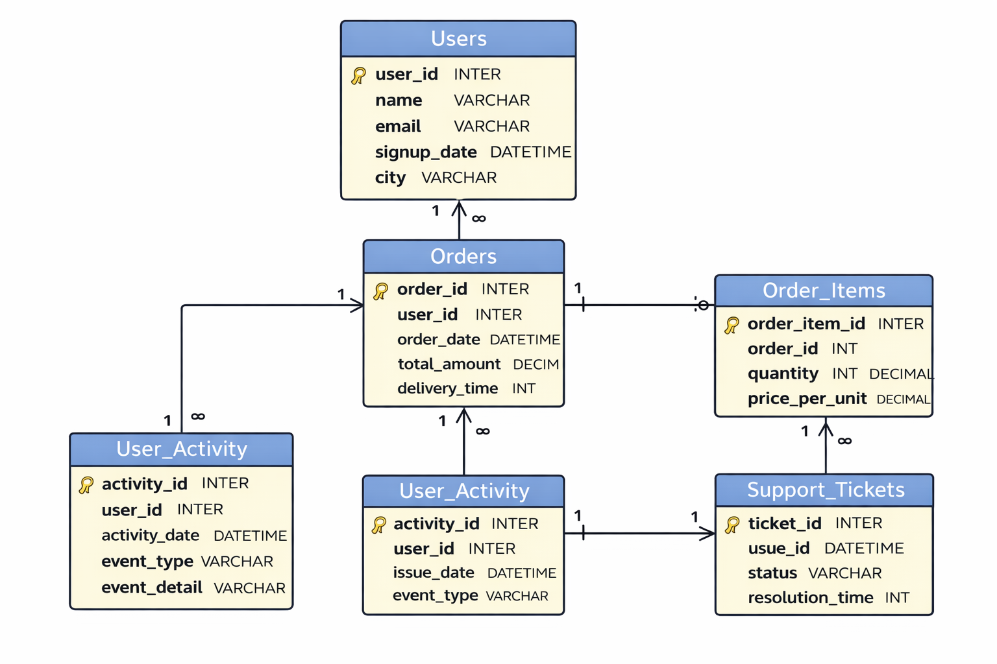
DATA MODEL & ER DIAGRAM
Entity Relationships:
Users ↓ Orders ↓ Order Items
Users ↓ User Activity
Users ↓ Support Tickets

Slide 6
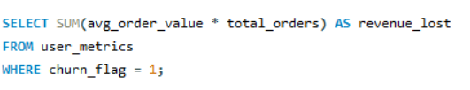

Q1. What is the total revenue lost due to churned users?
Insight :-
Churned users have contributed approximately ₹397K in historical revenue, representing a significant revenue leakage risk. This indicates that improving retention among churn-prone users can directly recover substantial revenue and strengthen overall business sustainability.

Slide 7
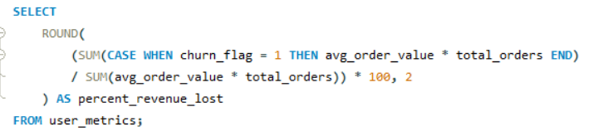

Q2. What percentage of total revenue comes from churned users?
Insight :-
Approximately 58.6% of total revenue has been generated by churned users, indicating significant revenue concentration among disengaged customers. This highlights a major retention gap and underscores the urgent need for proactive churn prevention strategies.

Slide 8


Q3. How much revenue is at risk from High-Risk users?
Insight :-
High-Risk users account for approximately ₹397K in revenue currently at risk, representing the largest concentration of potential revenue loss. Immediate targeted retention strategies for this segment could significantly reduce financial leakage and stabilize recurring revenue.

Slide 9
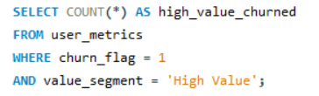

Q4. Among churned users, how many belong to the High Value segment?
Insight :-
A total of 405 High-Value customers have churned, representing a significant loss of premium revenue contributors. Retaining even a small portion of this segment could materially improve overall revenue performance and customer lifetime value.

Slide 10
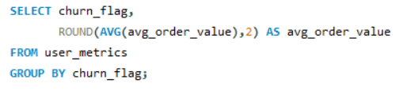
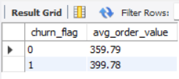
Q5. What is the average order value of churned vs retained users?
Insight :-
Churned users have a higher average order value (₹399.78) compared to retained users (₹359.79). This indicates that higher-spending customers are more likely to churn, creating disproportionate revenue impact.

Slide 11


Q6. What is the total lifetime revenue generated by churned users?
Insight :-
Nearly ₹397K in historical lifetime revenue is associated with churned customers, indicating significant value erosion. Preventing future churn in high-value segments could materially improve long-term revenue stability.

Slide 12
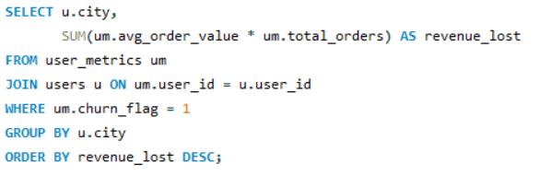
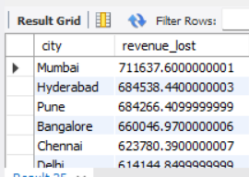
Q7. Which city contributes the highest revenue loss due to churn?
Insight :-
Mumbai shows the highest revenue loss due to churn (₹71.6K), followed closely by Hyderabad and Pune. This indicates that major metro cities contribute disproportionately to churn-related revenue leakage, requiring city-specific retention strategies.

Slide 13
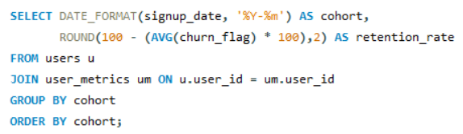
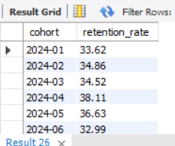
Q8. What is the retention rate of users grouped by signup month?
Insight :-
Cohort retention remains below 40% across all months, highlighting systemic retention challenges rather than isolated performance issues. Sustained improvements in onboarding and engagement strategies are required to drive long-term retention gains.

Slide 14
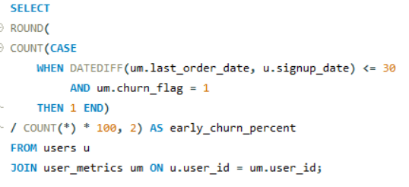

Q9. What percentage of users churn within 30 days of signup?
Insight :-
Approximately 28.4% of users churn within the first 30 days of signup, indicating significant early-stage disengagement. This suggests that onboarding experience and initial user engagement play a critical role in long-term retention.

Slide 15
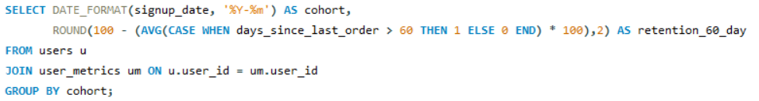
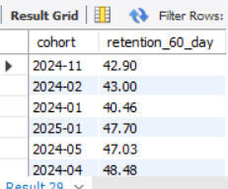
Q10. What is the 60-day retention rate by signup cohort?
Insight :-
60-day retention ranges between 40% and 48% across cohorts, indicating moderate long-term user stickiness. Recent cohorts (e.g., 2024-04 and 2025-01) show improved retention, suggesting potential improvements in onboarding quality or product experience.

Slide 16
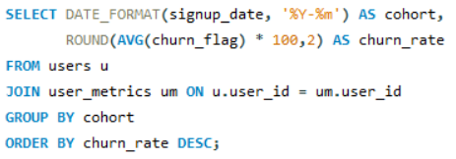
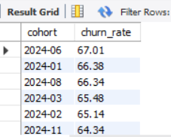
Q11. Which signup cohort has the highest churn rate?
Insight :-
Cohort-level churn remains consistently high across all signup months, ranging between 64% and 67%, indicating a structural retention challenge rather than a one-time issue. The 2024-06 cohort shows the highest churn (67%), suggesting potential acquisition quality or engagement gaps during that period.

Slide 17
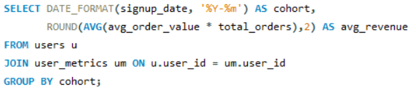
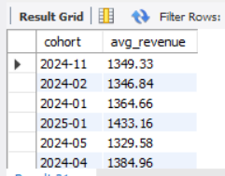
Q12. What is the average revenue per cohort (signup month basis)?
Insight :-
Average revenue per cohort remains relatively stable between ₹1,329 and ₹1,433, indicating consistent monetization performance across signup periods. However, despite stable revenue generation, high churn levels suggest revenue sustainability depends heavily on improving retention.

Slide 18
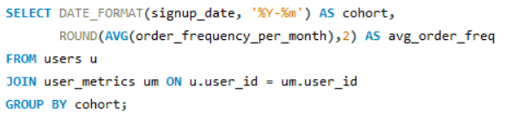
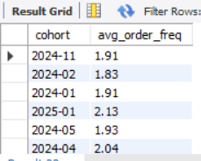
Q13. How does order frequency differ across cohorts?
Insight :-
Average order frequency remains stable across cohorts at approximately 2 orders per month, indicating consistent purchase behavior among active users. However, given high churn rates, sustaining and increasing ordering frequency is critical to improving long-term retention and lifetime value.

Slide 19
Q14. What is the average engagement score by cohort?
Insight :-
Average order frequency remains stable across cohorts at approximately 2 orders per month, indicating consistent purchase behavior among active users. However, given high churn rates, sustaining and increasing ordering frequency is critical to improving long-term retention and lifetime value.

Slide 20
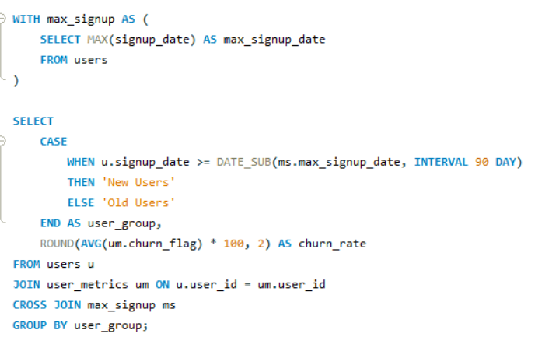
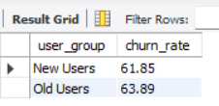
Q15. Are newer cohorts churning faster than older cohorts?
Insight :-
Churn rates between new users (61.85%) and old users (63.89%) are relatively similar, indicating that churn is not limited to early-stage users. This suggests a broader, systemic retention issue rather than an onboarding-only problem.

Slide 21

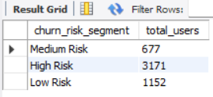
Q16. How many users fall into each churn_risk_segment?
Insight :-
A significant 63% of users fall into the High-Risk segment, indicating widespread disengagement across the customer base. This concentration of churn-prone users highlights an urgent need for proactive retention strategies and re-engagement campaigns.

Slide 22
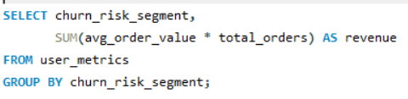
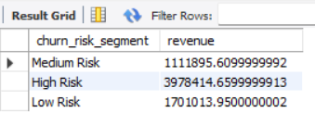
Q17. What is the revenue distribution across risk segments?
Insight :-
High-Risk users contribute approximately 58% of total revenue, representing the largest concentration of financial exposure. This indicates that revenue stability is heavily dependent on retaining churn-prone customers.

Slide 23
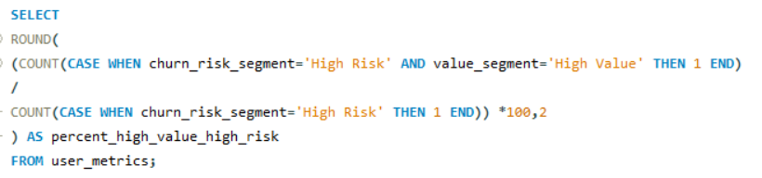

Q18. What percentage of High-Risk users are High-Value users?
Insight :-
Approximately 12.8% of High-Risk users belong to the High-Value segment, representing premium customers at immediate risk of churn. Retaining even a portion of this segment could deliver disproportionate revenue protection and improved lifetime value.

Slide 24
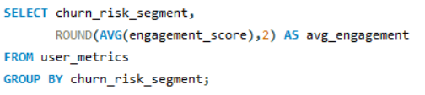
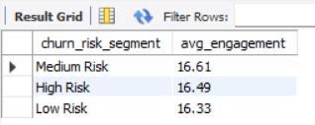
Q19. What is the average engagement score by churn risk segment?
Insight :-
Engagement scores are relatively similar across all risk segments, indicating that engagement volume alone is not a strong differentiator of churn risk. This suggests that other factors such as recency, experience quality, or order frequency may play a larger role in driving churn.

Slide 25
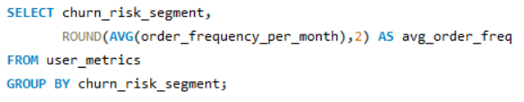
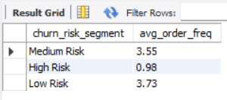
Q20. How does order frequency differ between Low-Risk and High-Risk users?
Insight :-
High-Risk users place fewer than 1 order per month on average (0.98), compared to 3.7 orders among Low-Risk users. Order frequency is a strong behavioral indicator of churn risk, highlighting the importance of habit formation in retention strategy.

Slide 26
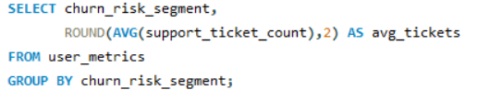
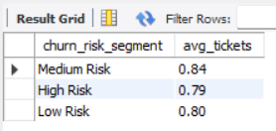
Q21. What is the support ticket count distribution by risk segment?
Insight :-
Average support ticket count is relatively consistent across all risk segments (~0.8 tickets per user), indicating that support volume alone does not strongly differentiate churn risk. This suggests that churn may be driven more by behavioral inactivity than by customer support frequency.

Slide 27
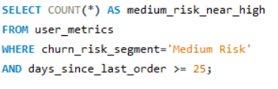

Q22. How many Medium-Risk users moved to High-Risk (simulate trend using recency)?
Insight :-
A total of 677 users fall into the Medium-Risk segment, representing customers at immediate risk of transitioning into High Risk. Proactive re-engagement strategies targeting this group could prevent further churn escalation.

Slide 28
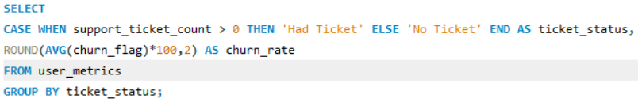
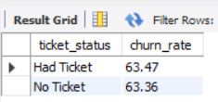
Q23. What is the churn rate among users who raised at least one support ticket?
Insight :-
Churn rates are nearly identical for users with support tickets (63.47%) and without tickets (63.36%), indicating that ticket occurrence alone does not significantly impact churn. This suggests that behavioral inactivity, rather than support interaction volume, is the primary churn driver.

Slide 29
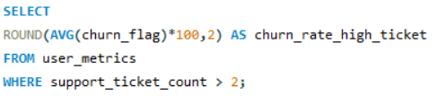

Q24. What is the churn rate for users with more than 2 tickets?
Insight :-
Users with more than two support tickets show a churn rate of 61.26%, slightly below the overall churn rate. This indicates that high ticket volume alone does not necessarily increase churn and may reflect engaged users seeking resolution.

Slide 30
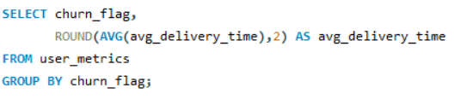

Q25. Does higher avg_delivery_time correlate with higher churn?
Insight :-
Churned users experience longer average delivery times (25.9 minutes) compared to retained users (23.4 minutes). This suggests that delivery delays may contribute to user dissatisfaction and increase churn probability.

Slide 31
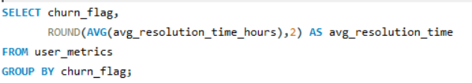
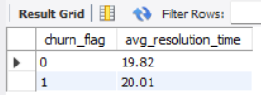
Q26. What is the average resolution time for churned vs retained users?
Insight :-
Average support resolution time is nearly identical between churned (20.01 hrs) and retained users (19.82 hrs), indicating minimal impact on churn. This suggests that resolution speed alone is not a primary driver of customer disengagement.

Slide 32
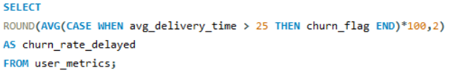

Q27. What is the churn rate among users who experienced delayed deliveries?
Insight :-
Users experiencing delivery times above 25 minutes exhibit a higher churn rate (65%) compared to the overall average. This indicates that delivery delays may contribute meaningfully to customer dissatisfaction and increased churn risk.

Slide 33
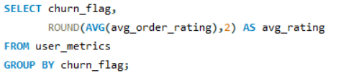
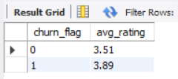
Q28. How does order_rating differ between churned and retained users?
Insight :-
Churned users exhibit a higher average order rating (3.89) compared to retained users (3.51), indicating that satisfaction scores alone do not prevent churn. This suggests that behavioral inactivity and habit decline are stronger churn drivers than customer rating feedback.

Slide 34
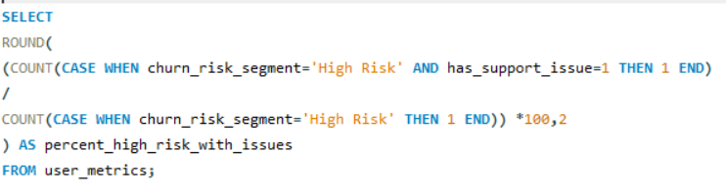

Q29. Among High-Risk users, what percentage have experience-related issues?
Insight :-
Over 54% of High-Risk users have experienced at least one support issue, suggesting that service friction may contribute to churn vulnerability. Improving issue prevention and resolution quality within this segment could help reduce churn escalation.

Slide 35
Business Recommendations
Increase monthly order frequency through habit-forming programs (streak rewards, subscription bundles, repeat-order incentives).
Launch targeted rescue campaigns for High-Value High-Risk users to protect premium revenue.
Improve delivery SLA performance and reduce orders exceeding 25 minutes to lower operational churn impact.
Deploy proactive retention nudges for Medium-Risk users (25–30 days inactivity window).
Strengthen first 30-day onboarding with structured incentives to reduce early lifecycle churn (28% early churn observed).
Implement real-time churn alert dashboard based on order frequency decline and recency signals.
Focus retention strategy at city level (Mumbai & top revenue-loss cities) to reduce concentrated revenue leakage.

Slide 36
Conclusion
The churn analysis reveals that customer attrition is primarily driven by behavioral inactivity rather than satisfaction or support-related issues. A significant 63% of users fall into the High-Risk segment, contributing to over 58% of total revenue at risk.
Order frequency decline emerged as the strongest predictor of churn, while delivery delays showed moderate impact. Engagement score, support ticket volume, resolution time, and order ratings demonstrated minimal influence on churn probability.
The findings indicate that retention strategy should shift from reactive support improvements to proactive behavioral habit formation, delivery optimization, and early lifecycle intervention. By focusing on frequency enhancement and high-value user protection, the business can significantly reduce revenue leakage and strengthen long-term customer retention.

